Slide 1
ENGLISH 4TH GRADE
Miss: María Fernanda Fernández Jeldres

Slide 2
OBJECTIVE: TO IDENTIFY THE PREPOSITIONS OF PLACE AND THE PLACES OF THE CITHY.
OBJETIVO: IDENTIFICAR LAS PREPOSICIONES DE LUGAR Y LOS LUGARES DE LA CIUDAD.
WHAT PREPOSITIONS OF PLACE DO YOU REMEMBER?
WHAT PLACES OF THE CITY DO YOU REMEMBER?

Slide 3
THE PLACES OF THE CITY.
THE PLACES OF THE CITY ARE DIFFERENT BUILDINGS THAT YOU CAN FIND IN A CITY AND WHERE YOU CAN DO DIFFERENT THINGS.
FOR EXAMPLE: IN A SCHOOL YOU CAN STUDY.
IN A RESTAURANT YOU CAN EAT.
LET’S SEE THE PLACES OF THE CITY THAT WE’LL LEARN!

Slide 4
PLACES OF THE CITY VOCABULARY.
PLACE OF THE CITY | MEANING | PRONUNCIATION
HOSPITAL | HOSPITAL | JOSPITAL
SCHOOL | COLEGIO | ESKUL
SUPERMARKET | SUPERMERCADO | SUPERMARKET
BANK | BANCO | BANK
POLICE STATION | ESTACION DE POLICIA | POLIS ESTEICHON
FIRE STATION | ESTACION DE BOMBEROS | FAYER ESTEICHON
CINEMA | CINE | CINEMA
RESTAURANT | RESTAURANTE | RESTORANT
PARK | PARQUE | PARK
TRAIN STATION | ESTACION DE TRENES | TREIN ESTEICHON
MALL | CENTRO COMERCIAL | MOL
STORE | TIENDA | ESTOR

Slide 5
PREPOSITIONS OF PLACE
THE PREPOSITIONS OF PLACE ARE SOME WORDS THAT CAN TELL US THE LOCATION OF AN OBJECT, PERSON, PLACE, ETC.
LAS PREPOSICIONES DE LUGAR SON PALABRAS QUE NOS INDICAN LA UBICACIÓN DE UN OBJETO, PERSONA, LUGAR, ETC.
LET’S SEE THE PREPOSITIONS OF PLACE THAT WE’LL LEARN.

Slide 6
PREPOSITIONS OF PLACES VOCABULARY.
PREPOSITION | MEANING | PRONUNCIATION
NEXT TO | AL LADO | NEXT TU
IN FRONT OF | FRENTE A | IN FRONT OV
BEHIND | DETRÁS | BIJAIN
BETWEEN | ENTRE | BITUIN
OPPOSITE | OPUESTO | OPOSIT
ON | EN | ON

Slide 7
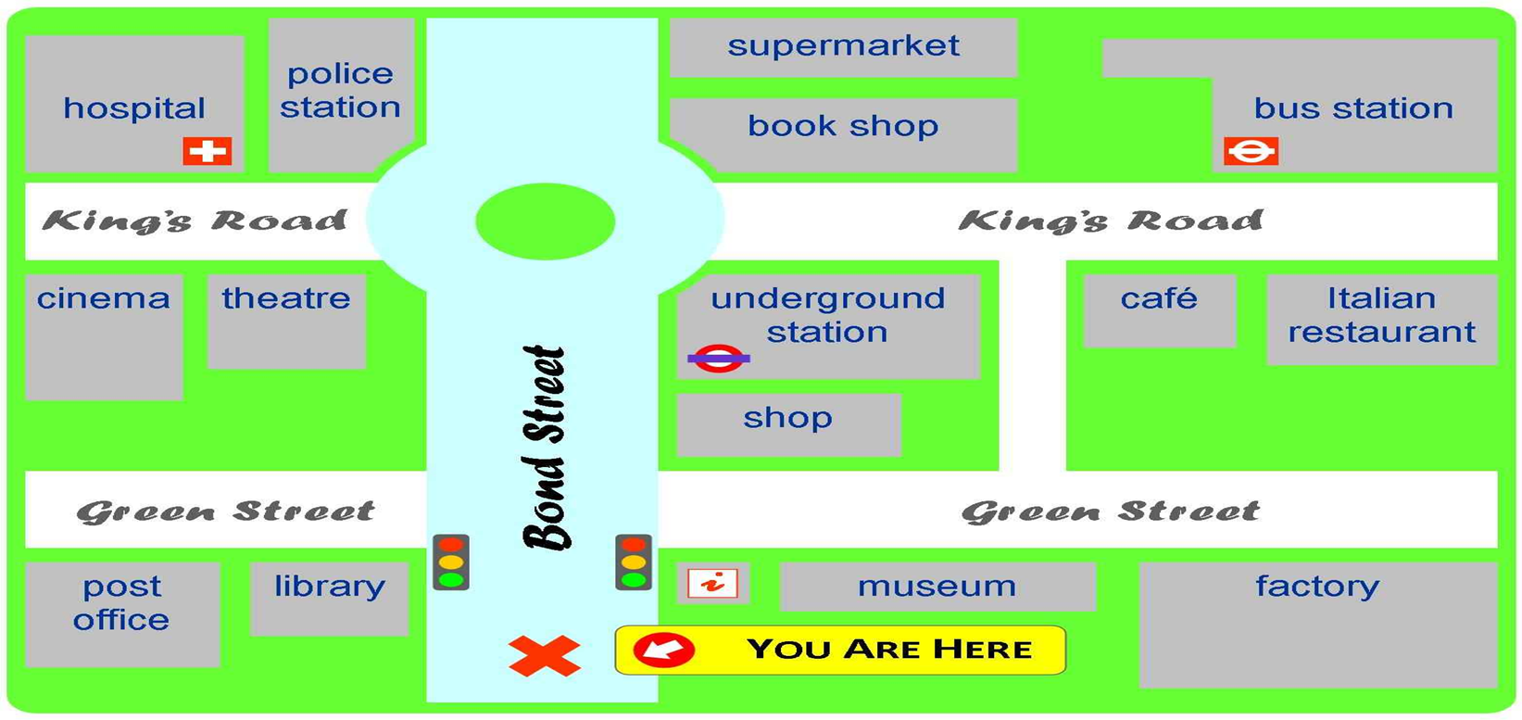
SOME EXAMPLES.
THE HOSPITAL IS NEXT TO THE POLICE STATION.
THE CINEMA IS OPPOSITE TO THE HOSPITAL.
THE SUPERMARKET IS BEHIND THE BOOK SHOP.
THE UNDERGROUND STATION IS IN FRONT OF THE SHOP.
THE CAFÉ IS BETWEEN THE ITALIAN RESTAURANT AND THE UNDERGROUND STATION.
THE HOSPITAL IS ON King’s Road.

Slide 8
LET’S LOOK AT THE PICTURE AND MAKE SENTENCES USING THE PLACES OF THE CITY AND THE PREPOSITIONS OF PLACE.

Slide 9
DO YOU HAVE ANY QUESTION ABOUT THE PREPOSITIONS OF PLACE?

Slide 10
NOW LET’S SEE THE WORKSHEET.

